Slide 1


Strategic Plan

Slide 2
Mission:
To advance the health of all individuals and communities. The AHA leads, represents and serves hospitals, health systems and other related organizations that are accountable to communities and committed to equitable care and health improvement for all.

Slide 3
Vision:
A just society of healthy communities, where all individuals reach their highest potential for health.

Slide 4

Disciplines
AHA's four work channels are approaches we use to provide value to members and advance our goals.
Advocacy and Representation
Thought
Leadership
Agents of Change
Knowledge
Exchange

Slide 5

Advocacy and Representation
Advance our strategic priorities in Congress, with the Administration, in courts, in media, in public opinion and beyond.
Thought
Leadership
Agents of Change
Knowledge
Exchange

Slide 6

Thought
Leadership
Utilize policy design, research, partnerships and innovations to accelerate improvements in health care delivery and reductions of disparities in health outcomes.
Advocacy and Representation
1
Thought
Leadership
Agents of Change
Knowledge
Exchange
Go Back
Go Next

Slide 7

Knowledge
Exchange
Facilitate the exchange of information, best practices and innovation to advance
the field.
Advocacy and Representation
1
Thought
Leadership
Agents of Change
Knowledge
Exchange
Go Back
Go Next

Slide 8
Agents of Change
Establish a shared position and related actions, including positioning members for effective advocacy, to enact change and define outcomes.
Advocacy and Representation
Thought
Leadership
Agents of Change
Knowledge
Exchange
Go Back
Go Next

Slide 9
Advocacy and Representation
Thought
Leadership
Agents of Change
Knowledge
Exchange
Strategic Principles
Go Back

Slide 10

Strategic Principles
Accessible
Affordable
Minimize Disparities
Safe and
High Quality
Sustainably
Staffed
Economically
Viable
Innovative
Coordinated
Person-centered
Go Back

Slide 11
Strategic Principles
Accessible
Affordable
Minimize Disparities
The health care ecosystem should provide timely access to the full continuum of health care services.
The health care ecosystem should provide coverage and care that is affordable.
The health care ecosystem should minimize disparities in health outcomes.
Go Back

Slide 12
Strategic Principles
Safe and
High Quality
Sustainably
Staffed
Economically
Viable
The health care ecosystem should be safe, high-quality, reliable and evidence based.
The health care ecosystem should be appropriately staffed, with a ready workforce and safe workplaces.
The health care ecosystem should be economically viable and appropriately resourced.
Go Back

Slide 13
Strategic Principles
Innovative
Coordinated
Person-centered
The health care ecosystem should be innovative, transformative, environmentally conscious and data driven.
The health care ecosystem should be committed to coordination and collaboration across all stakeholders.
The health care ecosystem should be oriented around the individual.
Go Back

Slide 14
STRATEGIES | PRINCIPLES
 | 1 | 2 | 3 | 4 | 5 | 6 | 7 | 8 | 9
Scale disruptive collaborations (e.g., Civica Rx, Truven) and establish unique partnership models with other stakeholders in the health care ecosystem. |  | X |  |  | X | X |  | X
Address public and policymaker understanding of the complexities of the cost of care and medical debt. | X | X |  |  |  | X |  | X
Optimize the Common Health Coalition* work plan to contribute to AHA principles. | X |  | X | X |  |  |  | X
Create new bridges between separate but interdependent pieces of the care delivery infrastructure. | X | X |  |  | X | X |  | X | X
Scale competencies in support of population segments with unique needs, e.g., aging, maternal and child, behavioral and mental health. | X |  | X |  |  |  | X | X | X
*The Common Health Coalition is the coalition formed by the AHA, American Medical Association, America’s Health Insurance Plans, Association for Community Health Plans and Kaiser Permanente to make improvements to the intersection between the health care delivery and public health infrastructures.

Slide 15
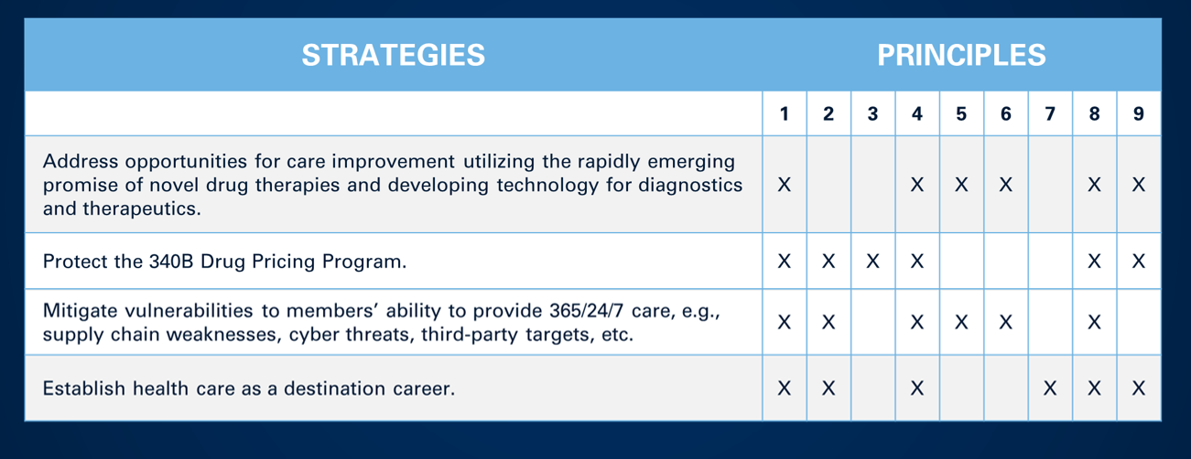

Slide 16
STRATEGIES | PRINCIPLES
 | 1 | 2 | 3 | 4 | 5 | 6 | 7 | 8 | 9
Scale and spread the successful new care models as designed by members. | X | X | X | X | X | X | X | X | X
Accelerate the utilization of technology to enhance the workforce. | X | X |  | X | X |  | X | X | X
Enhance public trust and confidence. |  |  | X | X |  | X |  | X
Improve the consumer experience. | X |  | X | X | X | X | X |  | X

Slide 17
STRATEGIES | PRINCIPLES
 | 1 | 2 | 3 | 4 | 5 | 6 | 7 | 8 | 9
Advance quality and patient safety through the Patient Safety Initiative. |  |  | X | X |  |  |  |  | X
Create meaningful progress towards care transformation and demonstrate improvements in accessibility, affordability, coordinated continuum and economic viability. | X | X |  |  | X | X |  | X | X
Improve and protect federal funding, including ACA subsidies. | X | X |  |  |  |  |  | X
Hold commercial insurers accountable and prevent insurance barriers to care. | X | X |  |  |  | X |  | X

